Slide 1



1
IMPACT OF COVID 19 ON AIR TRANSPORT
IN MIDDLE EAST
CAPT JYOTI GAYAN
Notes:
Greetings from QAA . Looking at COVID19 hopefully receding in our rearview mirror, we continue to find the EATEO the most apt platform to share our experience, engage, learn and adopt the best practices in aviation training
2. Like Europe, aviation in Middle East relies heavily on international traffic and hence faced the brunt of closed borders. After Europe, ME was the worst affected aviation region.
4. To appreciate the impact, we look into the aviation landscape of ME, where it stood at 2019 and where it stands today

Slide 2
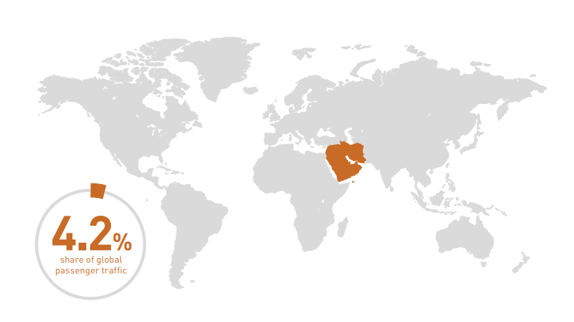

2
AVIATION IN MIDDLE EAST: THE AERIAL SILK ROUTE
CENTRALITY PROVIDES SEAMLESS CONNECTIVITY
1/3RD OF POPULATION ACCESSIBLE IN 4 HRS
2/3RD OF POPULATION ACCESSIBLE IN 8 HRS
Notes:
ME aviation have its roots in globalization as the centre of gravity shifted from the Atlantic to manufacturing hubs of Asia
Centrality; Developed West to emerging Asian economies, and Asian economies to new economies in Africa
Has 4.2% of the global passenger traffic but plays a significant role in global connectivity

Slide 3

3
AVIATION IN MIDDLE EAST: STRATEGIC ASPECTS
INTERNATIONAL SUPER CONNECTOR AMBITIONS: SUPER HUBS & SPOKES
SIXTH FREEDOM OPERATIONS: LIMITED OD AND INTRA-REGIONAL TRAFFIC
AIRPORT AIRLINE RELATIONSHIP: SYMBIOTIC RELATIONSHIP, TANDEM DEVELOPMENT
AVIATION AS A INTEGRATED ECOSYSTEM: INTERCONNECTED , INTERDEPENDENT
SYNERGISED WITH NATIONAL ASPIRATION: STATE OWNERSHIP AND DEVELOPMENT
Notes:
Target population is the business traveler, airlines provided premium services
Stopover, transit tourism, global convention centres
Aviation was never isolated business models, it was a synergized endeavour pursuing national aspirations

Slide 4
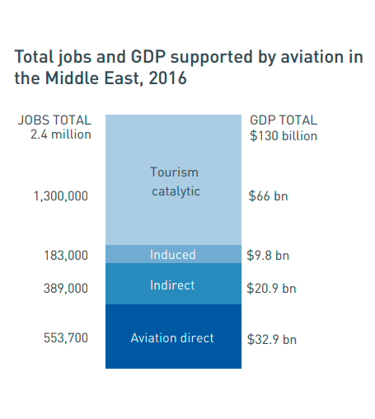
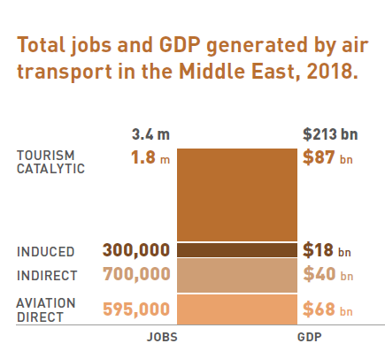
4
AVIATION IN MIDDLE EAST: AN INCREDIBLE GROWTH STORY
2/3RD OF POPULATION IN 8 HRS
1/3RD OF POPULATION IN 4 HRS
Credits: www.aviationbenefits.org

Slide 5

5
AVIATION IN MIDDLE EAST: 2019 SCENARIO
ANNUAL PASSENGER GROWTH STALLED TO 2.5-3%
AIRPORT INFRASTRUCTURE BULGING AT SEAMS
NEW MID CAPACITY LONG RANGE AIRCRAFT
STABLE LCC OPERATIONS CREATES A NICHE
ALLIANCES/ M&A HAD MIXED RESULTS
GROWING EXTRA REGIONAL COMPETITION

Slide 6

6
AVIATION IN MIDDLE EAST: TRANSFORMATION THROES
REINVENT THE NETWORKS: HYBRID P2P & HUB-SPOKE
AIRLINE CAPACITY BUILDING: ACQUISITION OF LATEST TECHNOLOGY
FORGE NEW ALLIANCES AND HARMONISATION
OPERATIONALISATION OF NEW AIRPORT TERMINALS
TRAINING NEEDS FOR AVIATION PROFESSIONALS
FOCUS ON ENVIRONMENTAL SUSTAINABILITY
Notes:
Sea of uncertainities

Slide 7


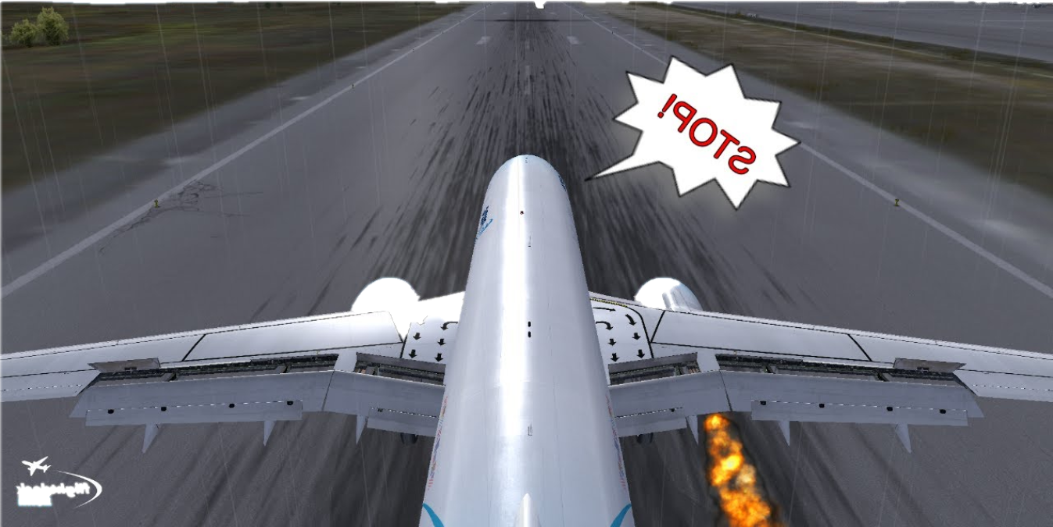
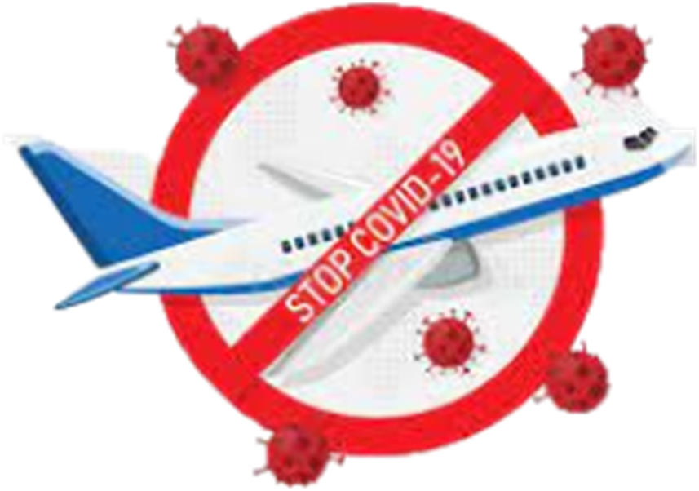

AVIATION IN MIDDLE EAST: MARCH 2020
7

Slide 8
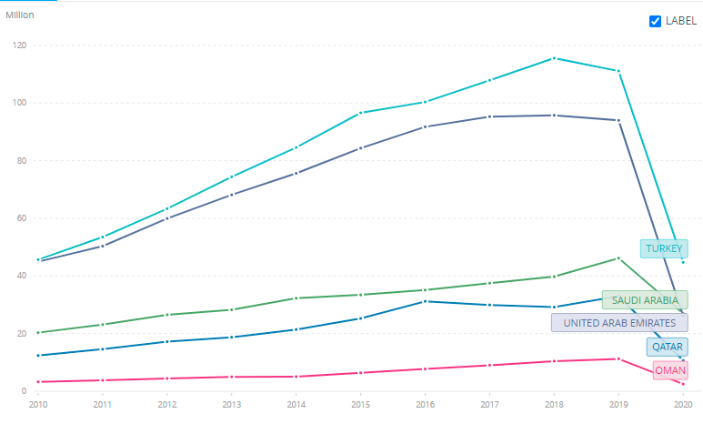
8
AVIATION IN MIDDLE EAST: IMPACT OF COVID 19
AIR TRANSPORT PASSENGERS CARRIED
-70.9%
2
0
2
0
Q1 -20.2%
Q2 -95.4%
Q3 -86.5%
Q4 -78.0%
2/3RD OF POPULATION IN 8 HRS
1/3RD OF POPULATION IN 4 HRS
2021: -64.2%
Credits: World Bank and ICAO data

Slide 9

9
AVIATION IN MIDDLE EAST: IMPACT OF COVID 19
SEAT CAPACITY REDUCTION
REVENUE IN USD
2
0
2
0
2
0
2
1
2
0
2
0
2
0
2
1
Q1 -19.4%
Q2 -89.8%
Q3 -73.7%
Q4 -61.4%
Q1 -56.2%
Q2 -51.5%
Q3 -45.0%
Q4 -33.3%
Q1 -1.4bn
Q2 -7.2bn
Q3 -7.5bn
Q4 -6.0bn
Q1 -5.6bn
Q2 -5.7bn
Q3 -5.5bn
Q4 -3.6bn
-61.3%
-46.4%
-22.1 bn
-20.4bn
Credits: World Bank and ICAO data

Slide 10
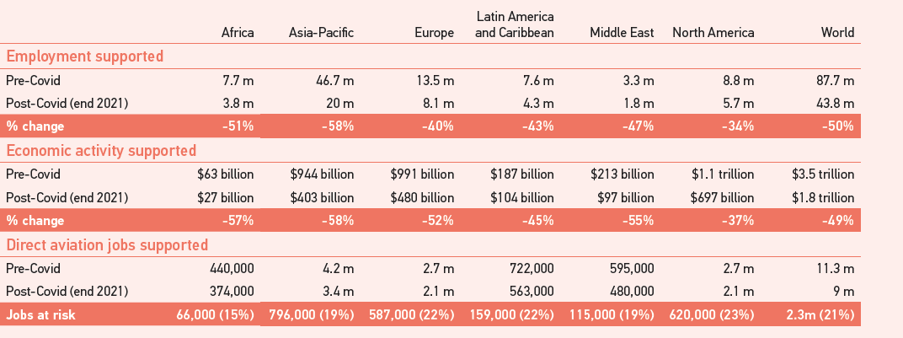
11
AVIATION IN MIDDLE EAST: IMPACT OF COVID 19
AVIATION BENEFITS
LOSS OF SKILLED PERSONNEL
2/3RD OF POPULATION IN 8 HRS
1/3RD OF POPULATION IN 4 HRS
Credits: www.aviationbenefits.org
Notes:
It’s not numbers alone but how to retrain, get the currencies. A major safety concerns

Slide 11

12
AVIATION IN MIDDLE EAST: THE RESILIENCE
STATE SUPPORTED INTERNATIONAL COMMUNICATION AND COLLABORATION
PUBLIC HEALTH SAFETY PROTOCOLS INCORPORATED TO OPERATIONS
AGILE SUPPORTIVE REGULATORY AUTHORITY
DISCIPLINED CAPACITY DOWNSIZING AND COST CONTROLS
OPERATIONAL SAFETY: TRAINING AND CONTROLS
Notes:
Need for continued international collaborative effort, highlights need for common forums to share, decide and implement
Fringe and the mainstream, the decision dilemma

Slide 12

13
AVIATION IN MIDDLE EAST: IMPACT OF COVID 19
REFLECT
AND
TRANSFORM

Slide 13

14
AVIATION IN MIDDLE EAST: ACCELERATED TRANSFORMATION
HYBRID HUB-SPOKE & P2P WITH THINNED FLIGHTS
ALTERNATE REVENUE GENERATION: CARGO, CHARTERS, AID & RELIEF
FLEET PLANNING
TEST BED FOR INNOVATIVE SOLUTIONS FROM BASELINE TECHNOLOGIES
INTEGRATION OF EVOLVING TRAINING TECHNOLOGIES
IDEAS TO ACTION
FOCUSED ON RESILIENCE AND RECOVERY
Notes:
1.Provided the much needed space and time to put Ideas into action
2. Experienced an agile decision making process
3. Balance between process and outcomes
4. Maybe imperfect at launch but perfected through experiences in implementation

Slide 14


IMPACT OF COVID 19: AVIATION FOREVER TRANSFORMED
FLUIDITY OF OPERATIONS
AGILE IDENTIFICATION AND ADAPTATION TO TRENDS
ALACRITY TO INNOVATIVE SOLUTIONS
ESTABLISH EFFECTIVE COMMUNICATION
COLLABORATIONS AT GLOBAL & LOCAL LEVELS
REASSERT STANDARDISATION BUT WITH LOCAL NORMALISATION
THE PAUSE
15
Notes:
Extremely data centric, but focused on live data and trends
Evolving models that are not based on precedence alone, but affected on merit
3. Aligned to EASA, provides a broader framework of understanding shared best practices

Slide 15
16
AVIATION IN MIDDLE EAST: IMPACT OF COVID 19
REDEFINED THE FUTURE
CHANGED THE ROADMAP
ACCELERATED THE TRANSFORMATION
REASSERTS THAT RESILIENCE AND SUSTAINABILITY IS THE KEY
Notes:
The aviation landscape is more interconnected and interdependent with our socio-economic structures
Shaken us from our comfort zones and made us agile
Agility comes from timely identification of trends through collaboration and sharing of ideas, and that makes us resilient
Business sustainability depends on this resilience

Slide 16
17
THANK YOU
Notes:
The pandemic was the darkest hour, but it reminded us of our biggest strength that to be resilient, to sustain, we have to hold hands, we cannot be islands anymore.

